Slide 1
levi9 CODE9 2021
Azure Cosmos Database
Vasilije Gavrić
Novi Sad, 24.05.2021

Slide 2
Agenda Slide
01
03
About Me
Demonstration in Azure
02
04
Cosmos DB intro
Questions and end slides

Slide 3
01. About me
Vasilije Gavrić
- Senior .Net developer
- More than 10 years experience
- Financial domain

Slide 4

Hobby

Slide 5
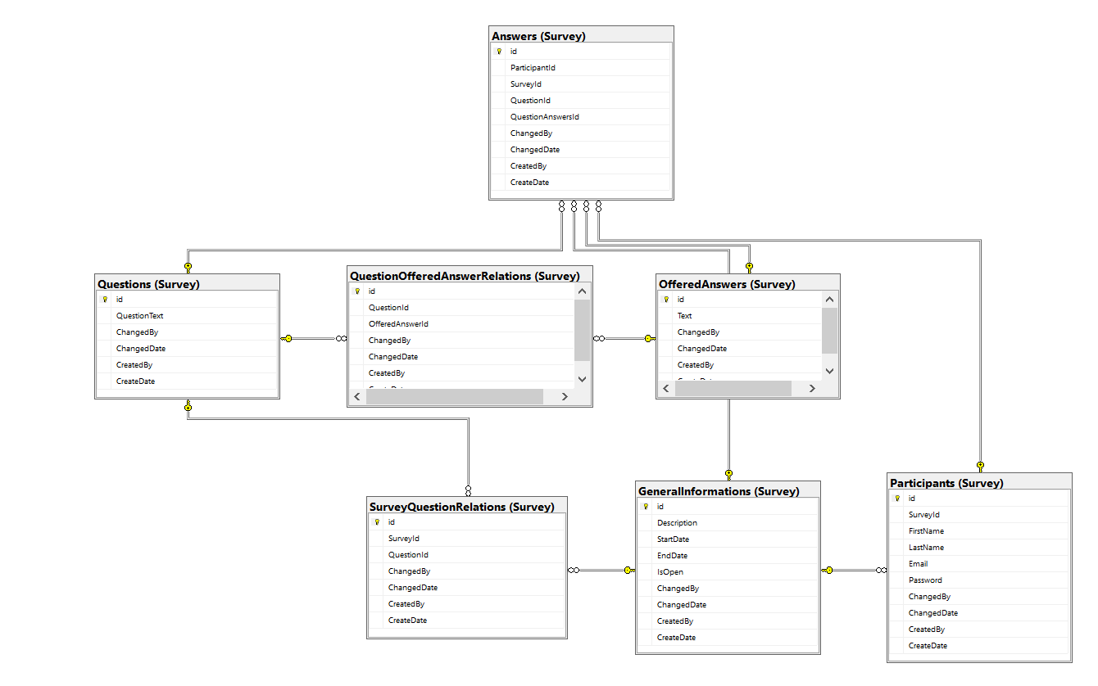
02. Cosmos DB intro
Comparison with SQL database

Slide 6
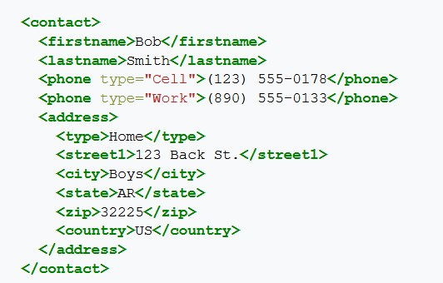
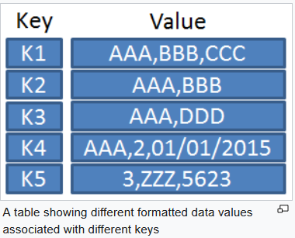
Cosmos DB supported database MODELS
- Document
- Key value

Slide 7
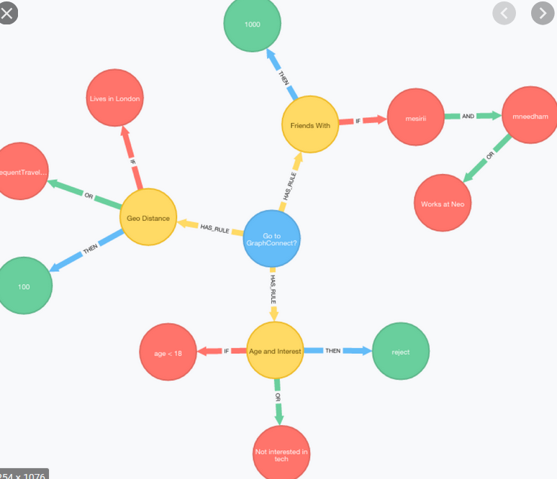
Cosmos DB supported database MODELS
Graph

Slide 8
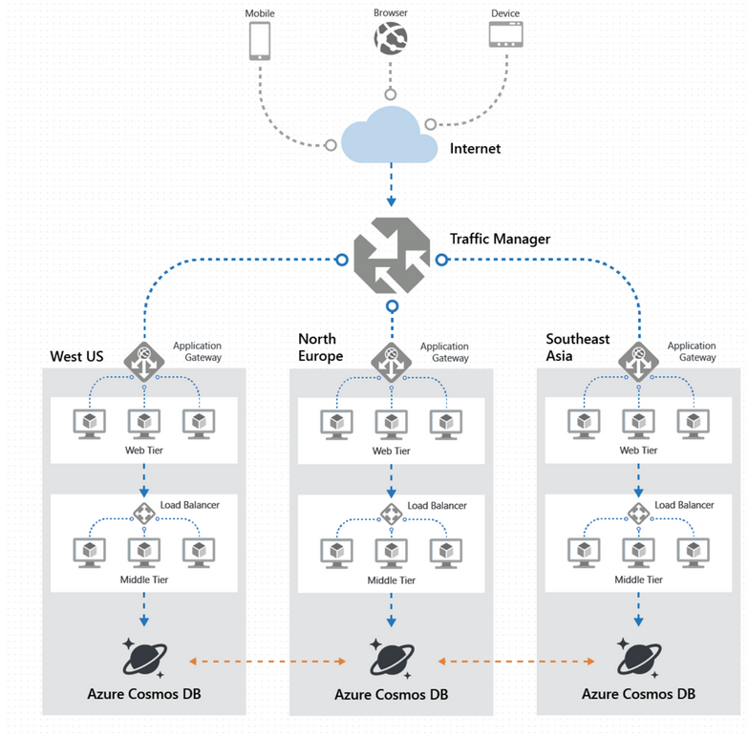
Globally distribution
Unlimited elastic wright and scalability
99.999% read and write availability all around the world
Guaranteed reads and writes server in less than 10 milliseconds at the 99th percents

Slide 9
HOSTING vs MONGO AS SERVICE
Server where we are installing mongoDB:
Maintaining server (VM machine under Azure)
Increase storage if it is needed
MongoDB as Service:
Azure will have automatically way to do this for us
We no need to worry about underlying structure
Automatically scale storage
Automatically scale compute
Also support many API’s: SQL(storing jsons), MongoDB (documents), Tables (ordinary tables). Gremlin (graph).

Slide 10
03. Demonstration iN azure
Creating CosmoDB:
Database account
Database
Container (Tables on SQL)
Item (Rows on SQL)
Partitioning of Cosmos DB:
Supports unlimited number of partitions
Partition can store up to 20GB of data
Partition key specified on container
Select is using firstly by partition key
Partition key can’t be changed. Another container should be created with different key and than migration to that container.
Each partiotion have Logical partition where data are segregted.
Items:
Every item have id
Id and partition key is unique
Notes:
We can’t make 100% to use partitionKey but we could make most of that.
Partition key should be something which is not changed frequently.

Slide 11
Partition key
{ "customerid": 1, "customername": "John", "city": "Miami" }
{ "customerid": 2, "customername": "Jane", "city": "New York" }
{ "customerid": 3, "customername": "Michael", "city": "Florda" }
{ "customerid": 4, "customername": "David", "city": "New York" }
Partition key is used for selecting data
Field is not something which should be changed frequently
600 throughput (200 per partitioning key)

Slide 12
Embedding data
{
"customerid": 1,
"customername": "John",
"city": "Miami",
"orders" : [{
"orderId": 1000,
"productId": 100,
"quantity": 2
}] }
No concept about foreign and primary key and relation between containers
When there is relations between entities
When we have multiple entities related to other
When embedded data changes infrequently

Slide 13
Referencing data
{
"customerid": 1,
"customername": "John", "city": "Miami",
"orders":[1000,1002]
}
{ "orderId": 1000, "productId": 100, "quantity": 2 }
{ "orderId": 1002, "productId": 101, "quantity": 4 }
- When representing one to many relations
- When representing many to many relations
- When there are related data changes

Slide 14
BACK to SQL

Slide 15
Questions

Slide 16
Thank you
Serbia / Novi sad
Levi9 Global Sourcing Balkan d.o.o.
Novi Sad Offices
Trifkovicev trg 6
21000 Novi Sad, Serbia

